Slide 1
Recipes from Dr. Ross
Enjoy!

Slide 2
Nut Crunchy Breakfast Cereal
Granola Ingredients:
½ cup of chopped almonds
½ cup of chopped pecans
¼ cup of chopped walnuts
½ cup of pumpkin seeds
½ cup unsweetened coconut
½ tsp cinnamon
Pinch sea salt
1 egg white
1 tsp vanilla

Slide 3
Granola Instructions for Nut Crunchy Breakfast Cereal
Preheat the oven to 300 degrees F. Line baking sheet with parchment paper. Set aside
In a large bowl, combine all the nutes, seeds, coconut, cinnamon and salt
Spread mixture in an even layer onto the prepared baking sheet and pat down flat with spatula
Bake 25-30 minutes or until golden brown, rotating the pan halfway through.
Remove from oven and allow to cool completely. Once cool break into clusters and store in airtight container. ** Feel free to add other nuts or seeds – I love chia, flax, sunflower and macadamia nuts – do not stir

Slide 4
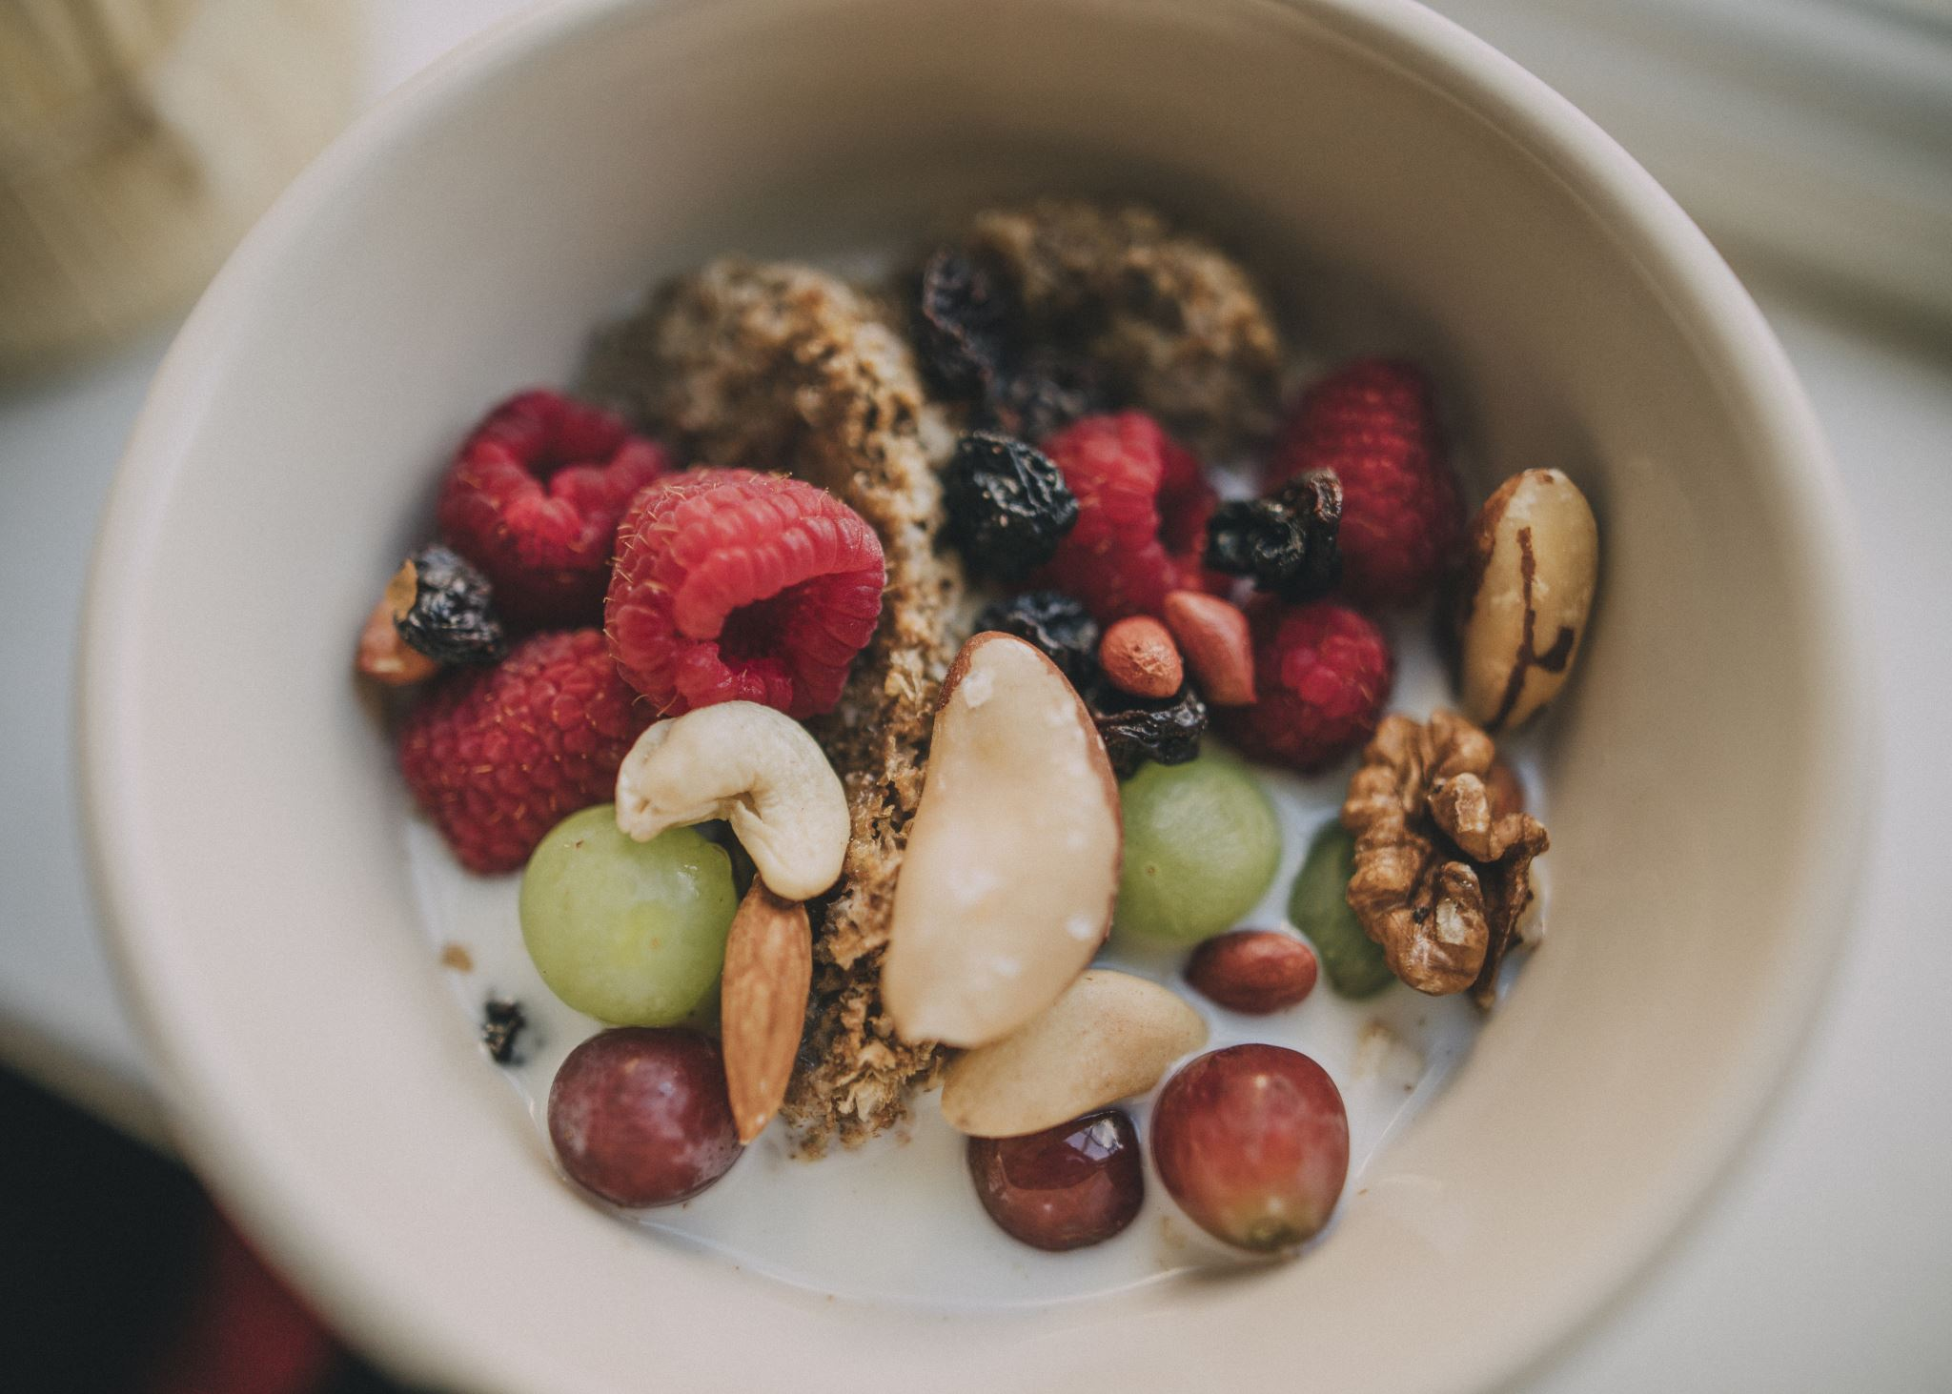
Nut Crunchy Breakfast Cereal
Macadamia Milk:
1 cup of raw unsalted macadamia nuts
3-4 cups of water
½ -1 tsp Vanilla
Pinch of Salt
1 date (optional)

Slide 5
Nut Crunchy Breakfast Cereal Macadamia Milk Instructions
Soak
Add
Pour
Store in
Soak macadamia nuts in cool water for 1-2 hours then drain and rinse.
Add macadamia nuts,3-4 cups filtered water, salt, vanilla and date if using to high speed blender – blend for two minutes until smooth – taste small amount
Pour and strain mixture through nut milk bag or thin towel – use single strain
Retain the pulp for other uses.
Store in sealed container in refrigerator for up to 5 days.

Slide 6
Nut Crunchy Breakfast Cereal
POUR MILK IN BOWL WITH GRANOLA AND YOUR FAVORITE TOPPING!
BON APPETIT!

Slide 7
Rise and Shine Smoothie
1 can Full Fat Unsweetened Coconut Milk
2 handfuls of fresh greens – spinach, kale, swiss chard, Arugula,
1 small nub of fresh ginger root peeled
1 granny smith apple with peel
2 carrots
1 avocado - pitted
1 scoop of collagen powder
1 rib celery
1 Tbsp Chia Seed
4 Walnuts
May add a date for sweetness ☺
1 organic lemon peeled
Add 1 cup of ice Blend until smooth
you need a strong highspeed blender
(I use a Vitamix)
Remember this is just food and you can try anything in your smoothie – be creative and share your results!

Slide 8
Not Your Mama’s Wok Fried Cauliflower Rice
1 head cauliflower
1 medium chopped onion or scallions
3 cloves minced garlic
2 carrots and 2 ribs celery chopped or cut into cubes
8 organic shitake mushrooms chopped or sliced
½ cup broccoli flowerets may chop smaller
2 Tbsp Coconut Oil
1 egg
¼ cup frozen peas – add at the end
1 pinch of coarse salt
Pepper to taste – may add crushed red pepper

Slide 9
Not Your Momma’s Wok Fried Cauliflower Rice Instructions
Place Cauliflower Flowerets in Blender and pulse. Don’t pulverize – should look like rice.
Melt 2 Tbsp of Coconut oil in wok or other large skillet may add more as needed
Add chopped onion and cook over medium heat until starts to become translucent about 2 minutes
Add garlic to onion and add pinch of sea salt with 1 tsp pepper
Add carrots, celery, mushrooms, broccoli and any other vegetables except for the rice cook for another 2-3 minutes
Add Rice and cook for about 5-7 minutes on medium heat
Mound rice making a center hole in the middle of the rice and break egg
Fry egg in center of rice until cooked and chop and add to rice
Feel free to substitute any other vegetables or proteins that you prefer!
You may also add stir fry sauce (see recipe) and or Sriracha sauce by Yellow Bird organic Lime Garlic and Date Blend

Slide 10
Stir Fry Sauce
1 cup coconut aminos
½ cup fresh orange juice – juice from one orange
¼ cup Red Boat Fish Sauce
2 tablespoons rice vinegar
2 teaspoons garlic powder
2 teaspoons ginger powder
1 teaspoon toasted sesame oil optional
Combine all of the ingredients in a small jar. Cover it tightly with a lid, and shake well to incorporate before using.
This sauce keeps in the refrigerator for up to 2 weeks. Don’t forget to shake well again before using it!
Courtesy of Nom Nom Paleo

Slide 11
Stir Fry Sauce
Combine all of the ingredients in a small jar. Cover it tightly with a lid, and shake well to incorporate before using.
This sauce keeps in the refrigerator for up to 2 weeks. Don’t forget to shake well again before using it!
Courtesy of Nom Nom Paleo

Slide 12
Avocado Chocolate Mousse Pudding Ingredients
1 avocado
1 large banana, or 2 small bananas
1 tsp melted coconut oil
4 pitted dates
1/4 cup water
2 tbsp cocoa powder
1 tsp vanilla
pinch of salt
dash of cinnamon (optional, but I LOVE this option)

Slide 13
Avocado Chocolate Mousse Pudding Instructions
Mix all ingredients in blender food or food processer
1 avocado
1 large banana, or 2 small bananas
1 tsp melted coconut oil
4 pitted dates
1/4 cup water
2 tbsp cocoa powder
1 tsp vanilla
pinch of salt
dash of cinnamon (optional, but I LOVE this option)

